Slide 1

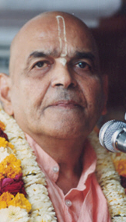
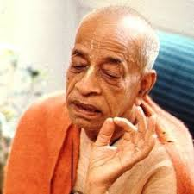
सहनशीलता Tolerate
Based on Bhagavat Saptah Lecture by HH Maha Vishnu Goswami Maharaj in Sydney

Slide 2
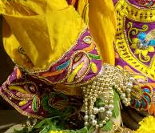
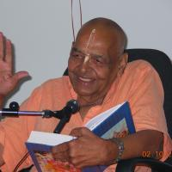
Recap
Duty in this age
Lead simple life
Don’t waste time in mental concoction
Utilize time in serious study of Bhagavatam
Medicine for this age
Hear, Study and Contemplate
Heart is meant for Krishna
Solution to our dissatisfaction
Spirit cannot be happy with matter.
Glorify Lord Sri Krishna
What is Real Wealth
Pleasing Krishna pleases everyone
Laxmi or Durga
Remembrance of Krishna

Slide 3
Recap
How to handle distress
Humbly Tolerance and have Patience
Improved karma leads to happiness
No one knows plan of the invisible actor
Art of Living
We have to go!
Blame yourself not others – See only Krishna
Eat sparingly and depend on Krishna
Dhruva Maharaj
Wish good to all and focus on Krishna!
God is great – worship Him
Take shelter of Krishna with determination
Bhisma Pitamah
Life of sacrifice
Doing duty in reverse circumstances
Seeing everything as Krishna’s favor

Slide 4
Recap
How to be fearless like Bhakta Prahlad
Chant Lord’s Names without delay
Fear personified fears Lord’s name
Worrying is business of Krishna

Slide 5
पुनरावृत्ति
इस युग में कर्तव्य
सादा जीवन जिए
मानसिक मनगढ़ंत में समय बर्बाद न करें
भागवतम् के गंभीर अध्ययन करें
इस युग के लिए दवा
तच्छृण्वन् सुपठन् विचारणपरो [SB 12.13.18]
हृदय कृष्ण के लिए है
हमारे असंतोष का समाधान
आत्मा पदार्थ से खुश नहीं हो सकती
भगवान कृष्ण की महिमा करें
वास्तविक धन क्या है
यास्मीन तुष्टे जगत् तुष्टे
लक्ष्मी या दुर्गा
कृष्ण का स्मरण

Slide 6
पुनरावृत्ति
संकट से कैसे निपटें ?
विनम्रता, धीरज, सभी का सम्मान
अच्छे कर्म से खुशी मिलती है
अदृश्य अभिनेता की योजना कोई नहीं जानता
जीने की कला
हमें जाना है
दूसरों को दोष न दें - केवल कृष्ण को देखें
संयमपूर्वक भोजन करें और कृष्ण पर निर्भर रहें
ध्रुव महाराज
सभी को शुभकामनाएं और कृष्ण पर ध्यान केंद्रित करें!
ईश्वर महान है - उसकी पूजा करो
निश्चय के साथ कृष्ण की शरण लें
भीष्म पितामह
बलिदान का जीवन
विपरीत परिस्थितियों कर्तव्य निभाना
सब कुछ में कृष्ण की कृपा देखना

Slide 7
पुनरावृत्ति
भक्त प्रह्लाद की तरह निडर कैसे बनें ?
बिना देर किए भगवान के नाम का जप करें
भय भी कृष्ण नाम से डरता है
चिंता करना कृष्ण का काम है

Slide 8
मात्रास्पर्शास्तु कौन्तेय शीतोष्णसुखदुःखदाः । आगमापायिनोऽनित्यास्तांस्तितिक्षस्व भारत ॥
mātrā-sparśās tu kaunteya śītoṣṇa-sukha-duḥkha-dāḥ āgamāpāyino ’nityās tāṁs titikṣasva bhārata
mātrā-sparśāḥ — sensory perception; tu — only; kaunteya — O son of Kuntī; śīta — winter; uṣṇa — summer; sukha — happiness; duḥkha — and pain; dāḥ — giving; āgama — appearing; apāyinaḥ — disappearing; anityāḥ — nonpermanent; tān — all of them; titikṣasva — just try to tolerate; bhārata — O descendant of the Bharata dynasty.
O son of Kuntī, the nonpermanent appearance of happiness and distress, and their disappearance in due course, are like the appearance and disappearance of winter and summer seasons. They arise from sense perception, O scion of Bharata, and one must learn to tolerate them without being disturbed. [2.14]

Slide 9
Discharge duty properly by tolerating
In the proper discharge of duty, one has to learn to tolerate nonpermanent appearances and disappearances of happiness and distress. According to Vedic injunction, one has to take his bath early in the morning even during the month of Māgha (January-February). It is very cold at that time, but in spite of that a man who abides by the religious principles does not hesitate to take his bath. Similarly, a woman does not hesitate to cook in the kitchen in the months of May and June, the hottest part of the summer season. One has to execute his duty in spite of climatic inconveniences. Similarly, to fight is the religious principle of the kṣatriyas, and although one has to fight with some friend or relative, one should not deviate from his prescribed duty. One has to follow the prescribed rules and regulations of religious principles in order to rise up to the platform of knowledge, because by knowledge and devotion only can one liberate himself from the clutches of māyā (illusion).
The two different names of address given to Arjuna are also significant. To address him as Kaunteya signifies his great blood relations from his mother’s side; and to address him as Bhārata signifies his greatness from his father’s side. From both sides he is supposed to have a great heritage. A great heritage brings responsibility in the matter of proper discharge of duties; therefore, he cannot avoid fighting.

Slide 10
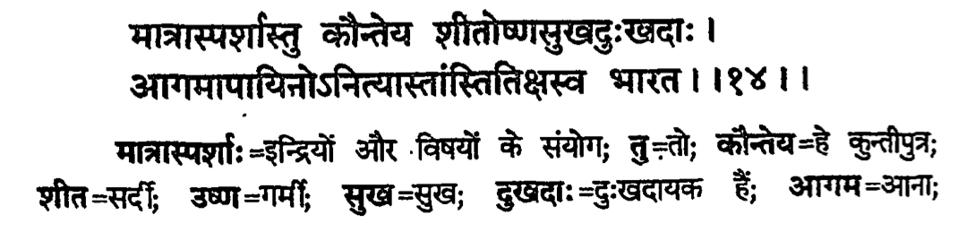
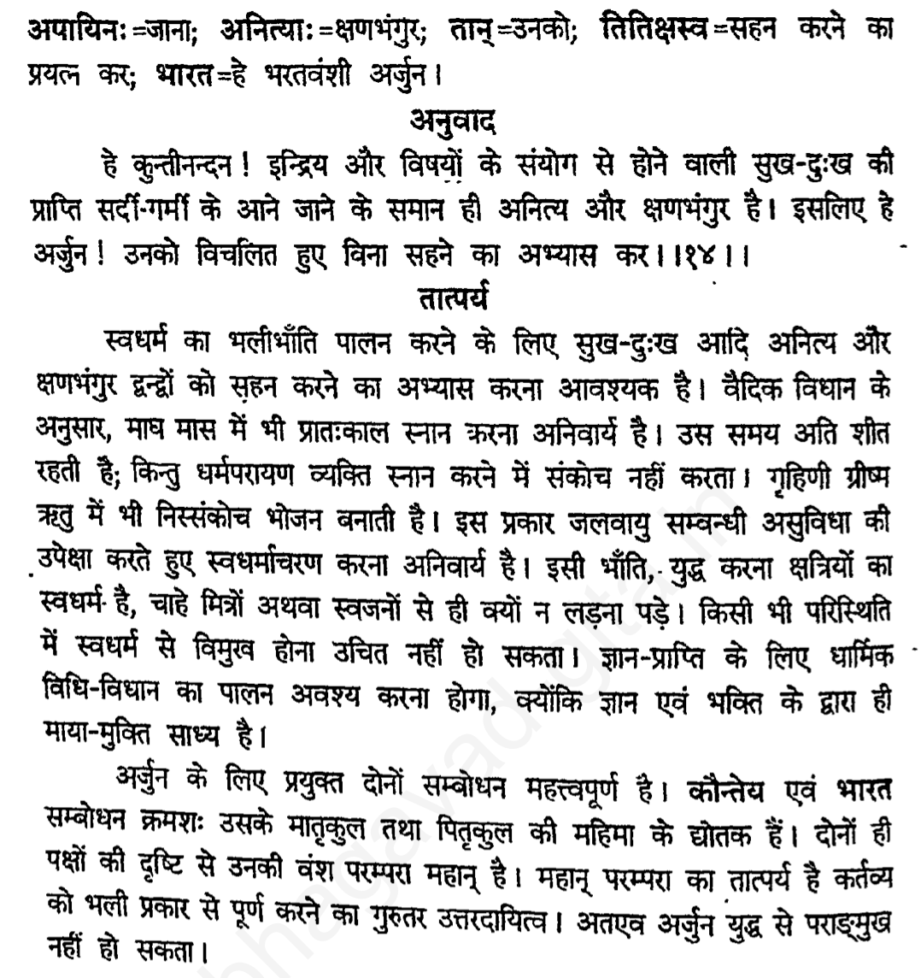

Slide 11

Whatever comes goes
Stop excessive sense gratification
Whatever comes has to go
Be ready to tolerate
Do not fret, fear, blame or take revenge
Save time and remember Krishna

Slide 12
जो आता है चला जाता है
अत्यधिक इन्द्रियतृप्ति बंद करो
सहन करने के लिए तैयार रहें
घबराओ मत, दोष मत दो या बदला मत लो
समय बचाएं और कृष्ण को याद करें

Slide 13
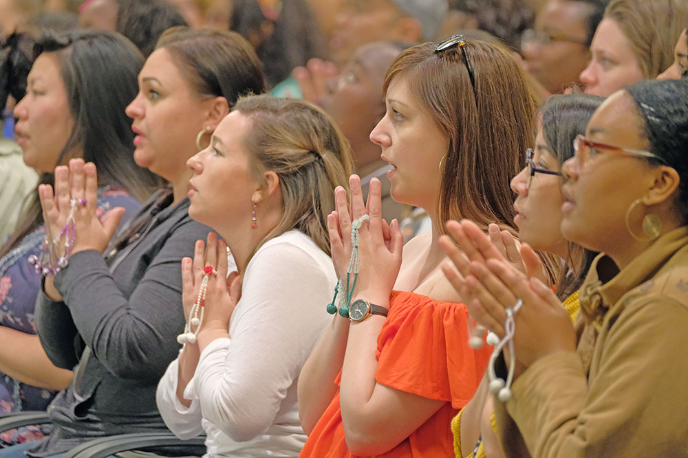
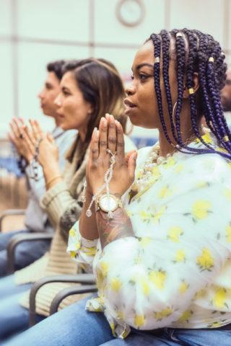
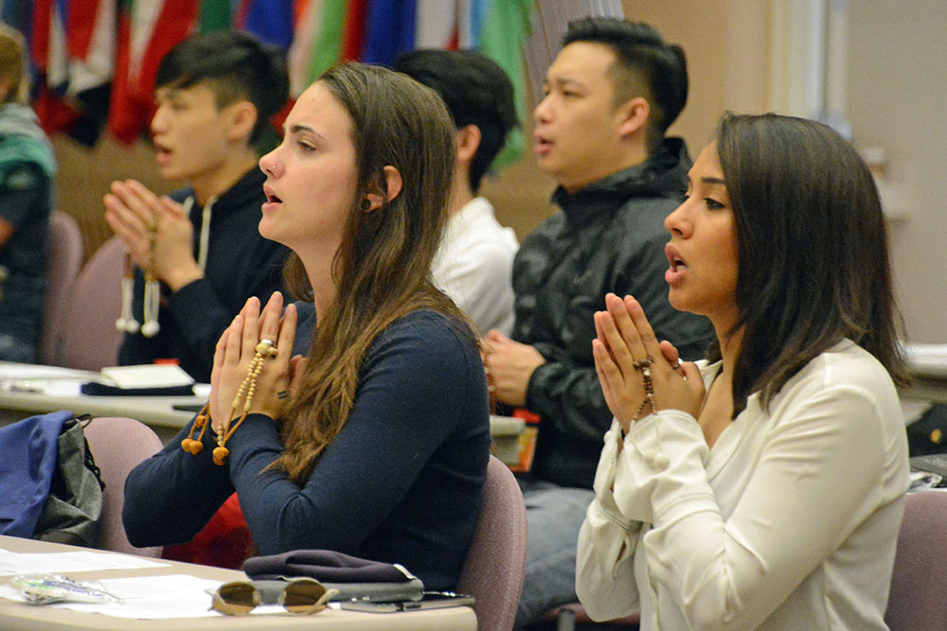
What to do in Misery?
Pray fervently to Lord in full surrender
Tolerate: Accept/Endure
Don’t worry
Don’t be angry or take revenge or think of hurting others
Introspect
think cause of misery & how to improve behavior
how much harm you have done to others
Accept, see hand of Krishna
Utilize time in reading scriptures

Slide 14
Sickness comes - it will go away
Misery/sickness is caused due to excessive sense gratification
Every misery/sickness has its own duration
Leave it to Krishna, Tolerate a bit, it will go away automatically
Don’t stuff food/medicine into your stomach
Make arrangement for living force (chetan shakti) to move freely
When you feel uneasy – stop eating
Utilize the time thus saved to remember Krishna thru the scriptures
Krishna can be remembered via scriptures
We can see Krishna through sastra cakshu and not charma cakshu

Slide 15
बीमारी आती है - चली जाएगी
अत्यधिक इन्द्रियतृप्ति के कारण दुख/रोग होता है
हर दुख/बीमारी की अपनी अवधि होती है
कृष्ण पर छोड़ दो, थोड़ा सह लो, अपने आप चली जाएगी
अपने पेट में भोजन / दवा न भरें
चेतन शक्ति को स्वतंत्र रूप से चलने की व्यवस्था करें
जब आप असहज महसूस करते हैं – खाना बंद कर दें
शास्त्रों के माध्यम से कृष्ण को याद करने के लिए समय बचाएं
कृष्ण को शास्त्रों के माध्यम से याद किया जा सकता है
हम कृष्ण को शास्त्र चक्षु के माध्यम से देख सकते हैं, चर्म चक्षु से नहीं

Slide 16
tṛṇād api su-nīcena taror iva sahiṣṇunā amāninā māna-dena kīrtanīyaḥ sadā hariḥ
tṛṇāt api — than downtrodden grass; su-nīcena — being lower; taroḥ — than a tree; iva — like; sahiṣṇunā — with tolerance; amāninā — without being puffed up by false pride; māna-dena — giving respect to all; kīrtanīyaḥ — to be chanted; sadā — always; hariḥ — the holy name of the Lord.
“One who thinks himself lower than the grass, who is more tolerant than a tree, and who does not expect personal honor yet is always prepared to give all respect to others can very easily always chant the holy name of the Lord.” [CC A.17.31 ]
The grass is specifically mentioned in this verse because everyone tramples upon it yet the grass never protests. This example indicates that a spiritual master or leader should not be proud of his position; being always humbler than an ordinary common man, he should go on preaching the cult of Caitanya Mahāprabhu by chanting the Hare Kṛṣṇa mantra.

Slide 17
ūrdhva-bāhu kari’ kahoṅ, śuna, sarva-loka nāma-sūtre gāṅthi’ para kaṇṭhe ei śloka
ūrdhva-bāhu — raising my hands; kari’ — doing so; kahoṅ — I declare; śuna — please hear; sarva-loka — all persons; nāma — of the holy name; sūtre — on the thread; gāṅthi — stringing; para — get it; kaṇṭhe — on the neck; ei — this; śloka — verse.
Raising my hands, I declare, “Everyone please hear me! String this verse on the thread of the holy name and wear it on your neck for continuous remembrance.” [CC A.17.32 ]
When chanting the Hare Kṛṣṇa mahā-mantra, in the beginning one may commit many offenses, which are called nāmābhāsa and nāma-aparādha. In this stage there is no possibility of achieving perfect love of Kṛṣṇa by chanting the Hare Kṛṣṇa mahā-mantra. Therefore one must chant the Hare Kṛṣṇa mahā-mantra according to the principles of the above verse, tṛṇād api su-nīcena taror iva sahiṣṇunā. One should note in this connection that chanting involves the activities of the upper and lower lips as well as the tongue. All three must be engaged in chanting the Hare Kṛṣṇa mahā-mantra. The words “Hare Kṛṣṇa” should be very distinctly pronounced and heard. Sometimes one mechanically produces a hissing sound instead of chanting with the proper pronunciation with the help of the lips and tongue. Chanting is very simple, but one must practice it seriously. Therefore the author of Śrī Caitanya-caritāmṛta, Kṛṣṇadāsa Kavirāja Gosvāmī, advises everyone to keep this verse always strung about his neck.

Slide 18
prabhu-ājñāya kara ei śloka ācaraṇa avaśya pāibe tabe śrī-kṛṣṇa-caraṇa
prabhu — of the Lord; ājñāya — on the order; kara — do; ei śloka — of this verse; ācaraṇa — practice; avaśya — certainly; pāibe — he will get; tabe — afterwards; śrī-kṛṣṇa-caraṇa — the lotus feet of Lord Kṛṣṇa.
One must strictly follow the principles given by Lord Caitanya Mahāprabhu in this verse. If one simply follows in the footsteps of Lord Caitanya and the Gosvāmīs, certainly he will achieve the ultimate goal of life, the lotus feet of Śrī Kṛṣṇa.

Slide 19
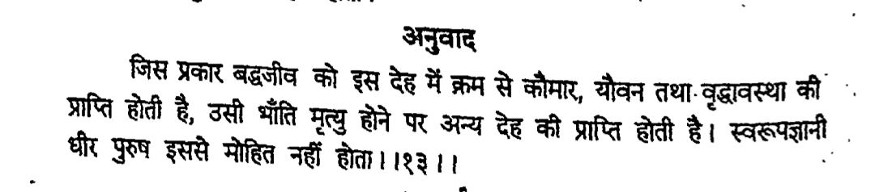
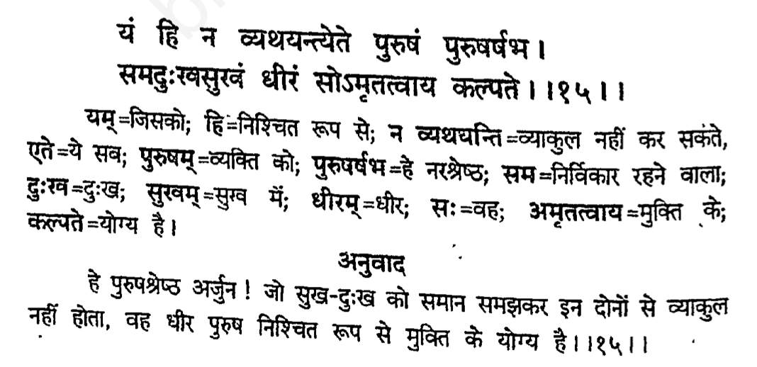
देहिनोऽस्मिन्यथा देहे कौमारं यौवनं जरा । तथा देहान्तरप्राप्तिर्धीरस्तत्र न मुह्यति ॥

Slide 20
Learning to tolerate leads to liberation
As the embodied soul continuously passes, in this body, from boyhood to youth to old age, the soul similarly passes into another body at death. A sober person is not bewildered by such a change.
O son of Kuntī, the nonpermanent appearance of happiness and distress, and their disappearance in due course, are like the appearance and disappearance of winter and summer seasons. They arise from sense perception, O scion of Bharata, and one must learn to tolerate them without being disturbed.
O best among men [Arjuna], the person who is not disturbed by happiness and distress and is steady in both is certainly eligible for liberation.

Slide 21
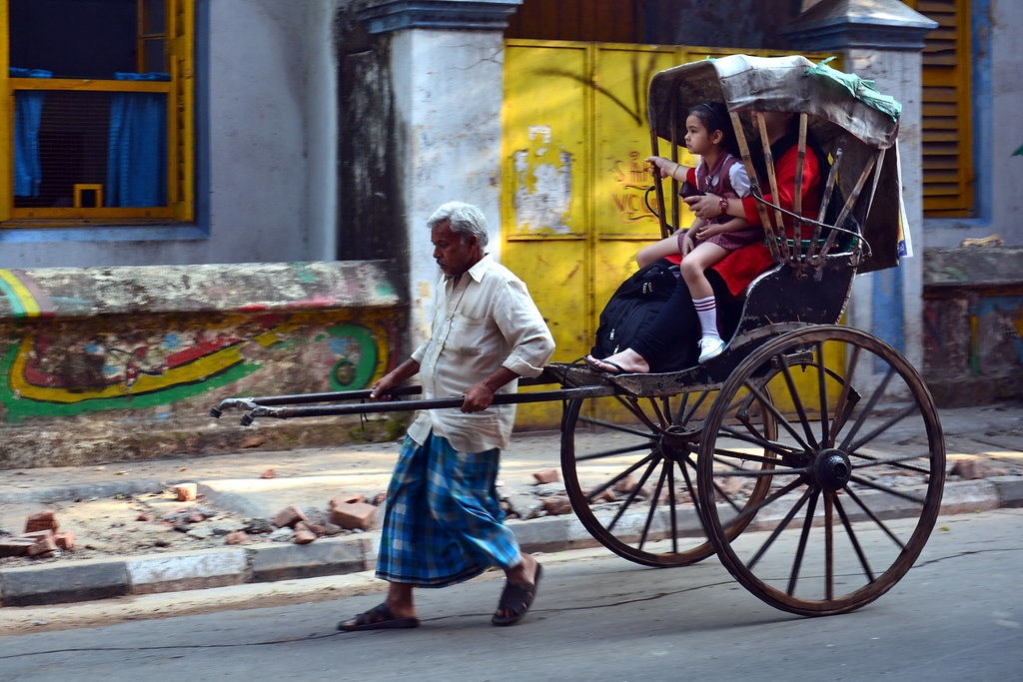
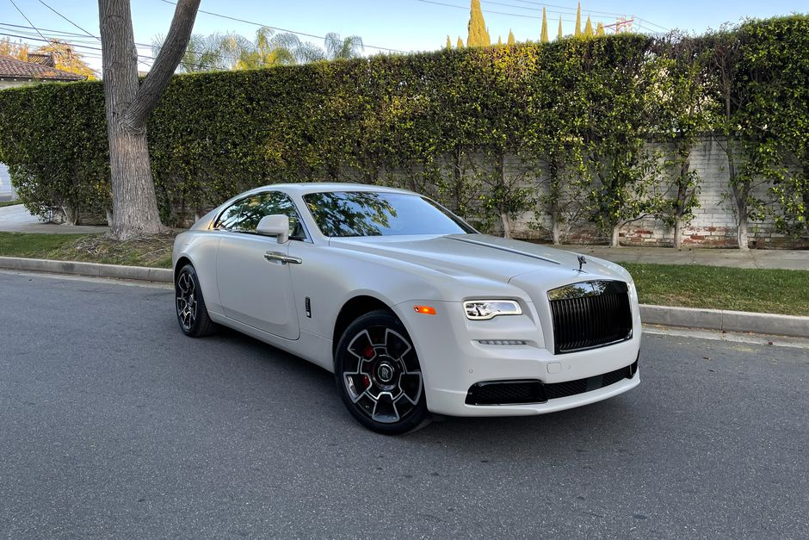
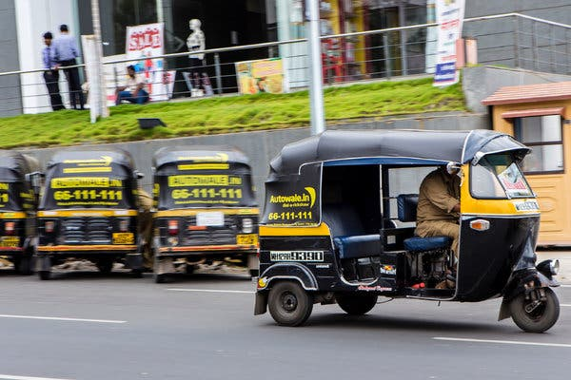
Body Consciousness
We identity with the vehicle we are in

Slide 22
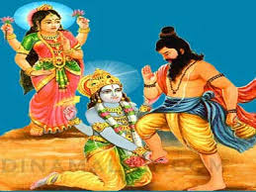
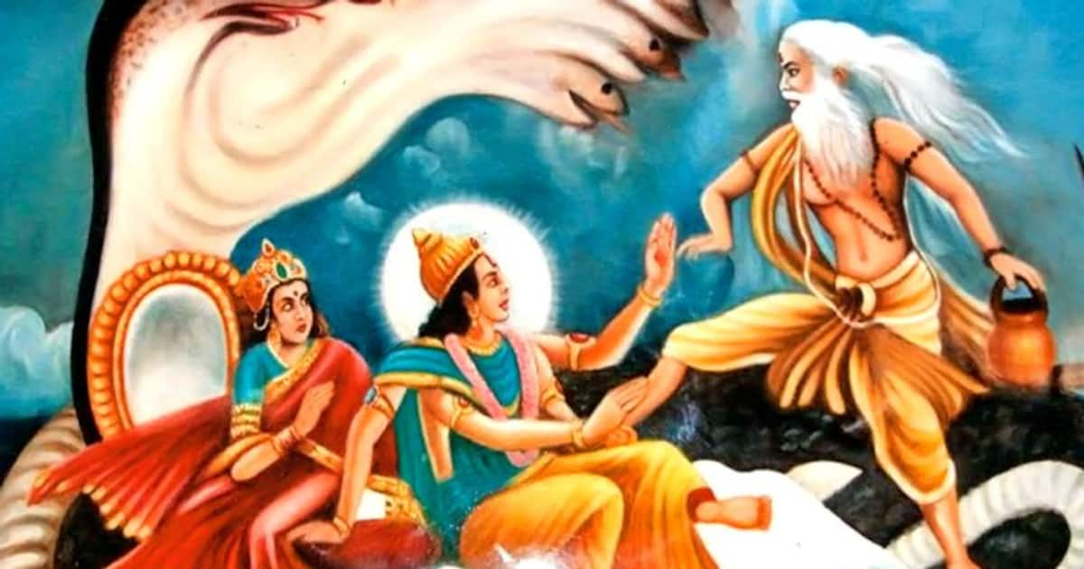
Who is the greatest? Brahma, Vishnu or Siva
Bhrigu decided to test the Lords’ tolerance [SB 10.89.1-20]
One who is in the mode of goodness possesses such qualities as tolerance and equanimity, whereas those conducted by the modes of passion and ignorance are prone to easily lose their temper.

Slide 23
Lord Krishna amazing response when Bhṛgu Muni kicks Him
There he went up to the Supreme Lord, who was lying with His head on the lap of His consort, Śrī, and kicked Him on the chest. The Lord then rose, along with Goddess Lakṣmī, as a sign of respect. Coming down from His bedstead, that supreme goal of all pure devotees bowed His head to the floor before the sage and told him, ‘Welcome, brāhmaṇa. Please sit in this chair and rest awhile. Kindly forgive us, dear master, for not noticing your arrival.’ [SB 10.89.8-9]
My dear sir, O great sage, your feet are indeed very tender.’ Saying this, Lord Viṣṇu began massaging the brāhmaṇa’s feet with His own hands.
“Please purify Me, My realm and the realms of the universal rulers devoted to Me by giving us the water that has washed your feet. This holy water is indeed what makes all places of pilgrimage sacred. Today, my lord, I have become the exclusive shelter of the goddess of fortune, Lakṣmī; she will consent to reside on My chest because your foot has rid it of sins.” [SB 10.89.10-11]

Slide 24
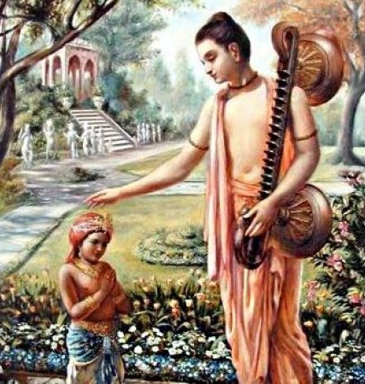
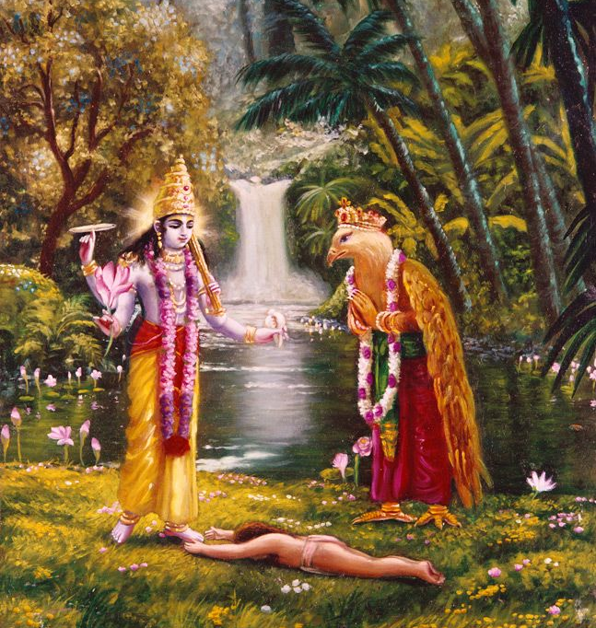
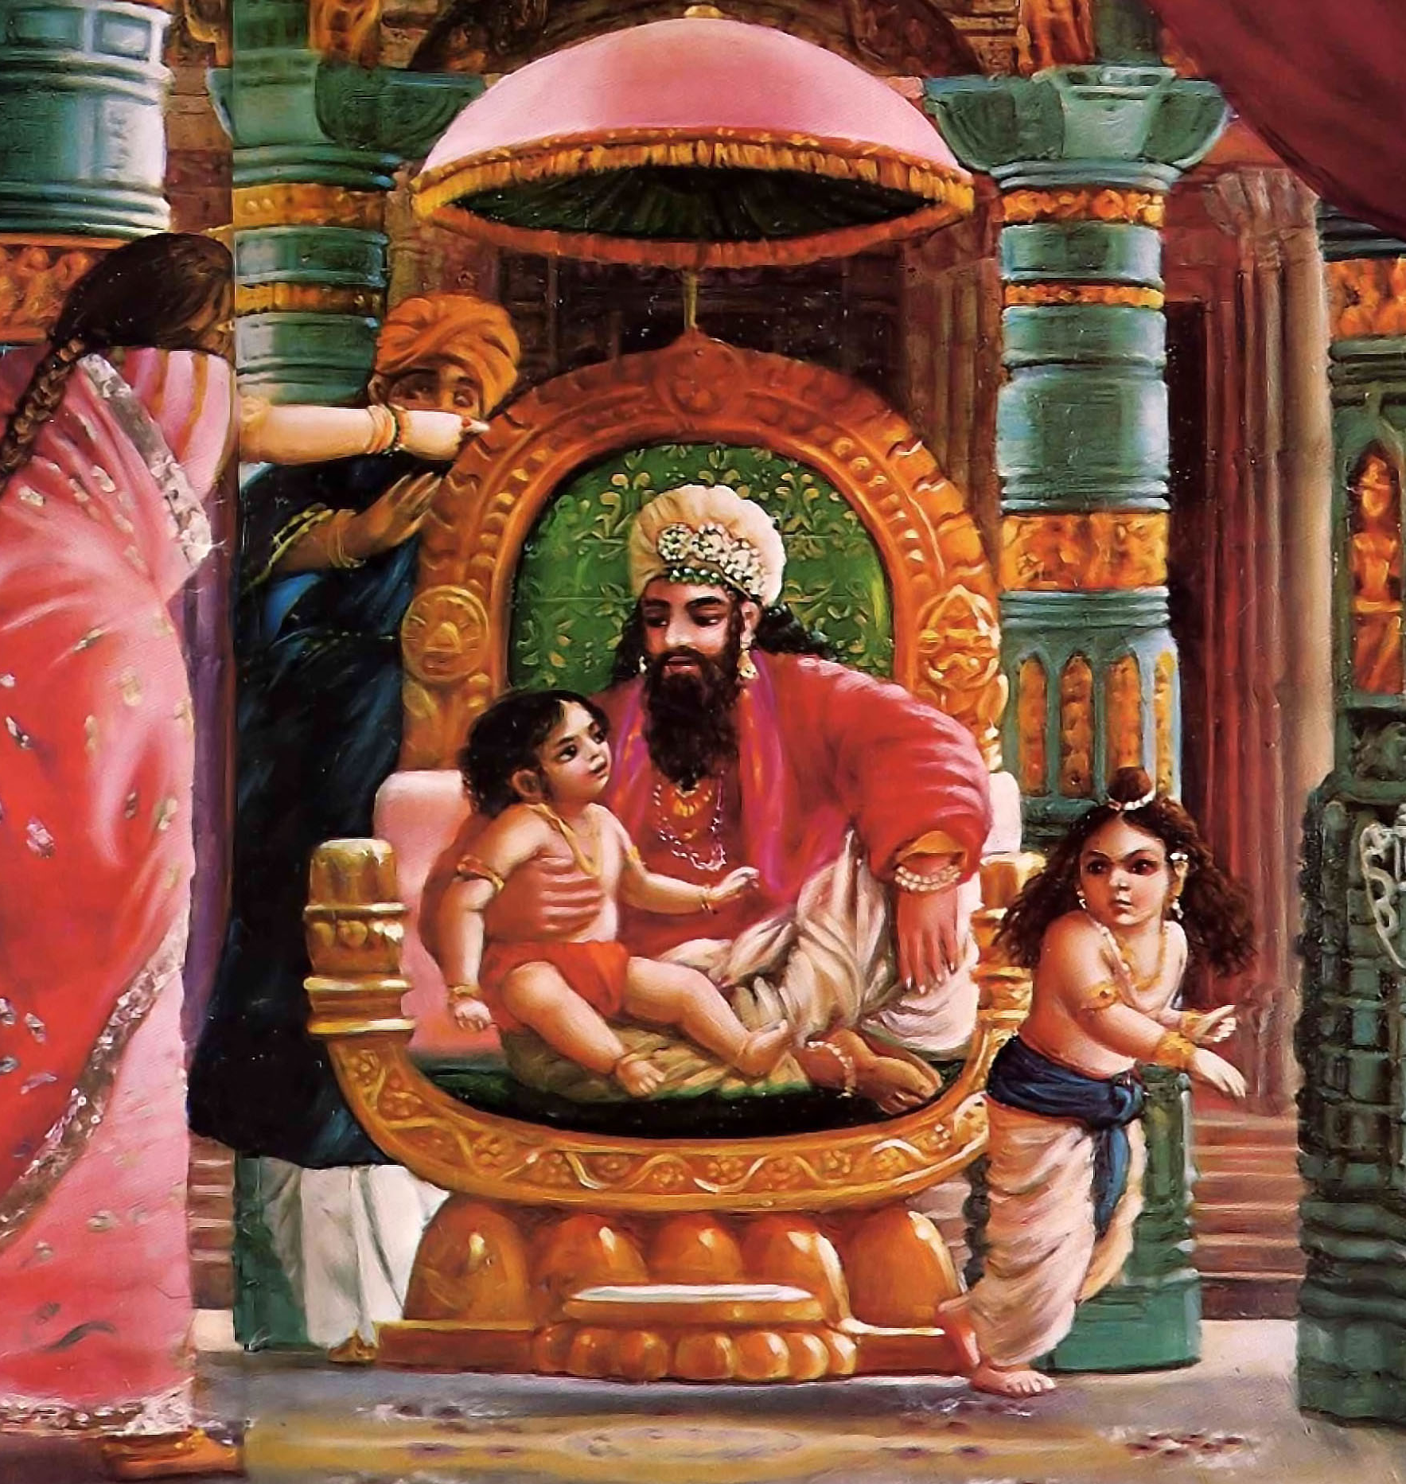
No retaliation
We should never think ill of anyone
We should tolerate and take determined refuge of Krishna under able guidance
Tolerance in leads to one to Krishna feet

Slide 25
दीर्घं श्वसन्ती वृजिनस्य पार- मपश्यती बालकमाह बाला । मामङ्गलं तात परेषु मंस्था भुङ्क्ते जनो यत्परदु:खदस्तत् ॥
dīrghaṁ śvasantī vṛjinasya pāram apaśyatī bālakam āha bālā māmaṅgalaṁ tāta pareṣu maṁsthā bhuṅkte jano yat para-duḥkhadas tat
She also was breathing very heavily, and she did not know the factual remedy for the painful situation. Not finding any remedy, she said to her son: My dear son, don’t wish for anything inauspicious for others. Anyone who inflicts pains upon others suffers himself from that pain. [SB 4.8.17]
Please in dream also, don’t think any inauspicious thing, about any other living entity. [HH MahaVishnu Maharaj]

Slide 26
या निर्वृतिस्तनुभृतां तव पादपद्म ध्यानाद्भवज्जनकथाश्रवणेन वा स्यात् । सा ब्रह्मणि स्वमहिमन्यपि नाथ मा भूत् किं त्वन्तकासिलुलितात्पततां विमानात् ॥
My Lord, the transcendental bliss derived from meditating upon Your lotus feet or hearing about Your glories from pure devotees is so unlimited that it is far beyond the stage of brahmānanda, wherein one thinks himself merged in the impersonal Brahman as one with the Supreme. Since brahmānanda is also defeated by the transcendental bliss derived from devotional service, then what to speak of the temporary blissfulness of elevating oneself to the heavenly planets, which is ended by the separating sword of time? Although one may be elevated to the heavenly planets, he falls down in due course of time. [SB 4.9.10]

Slide 27
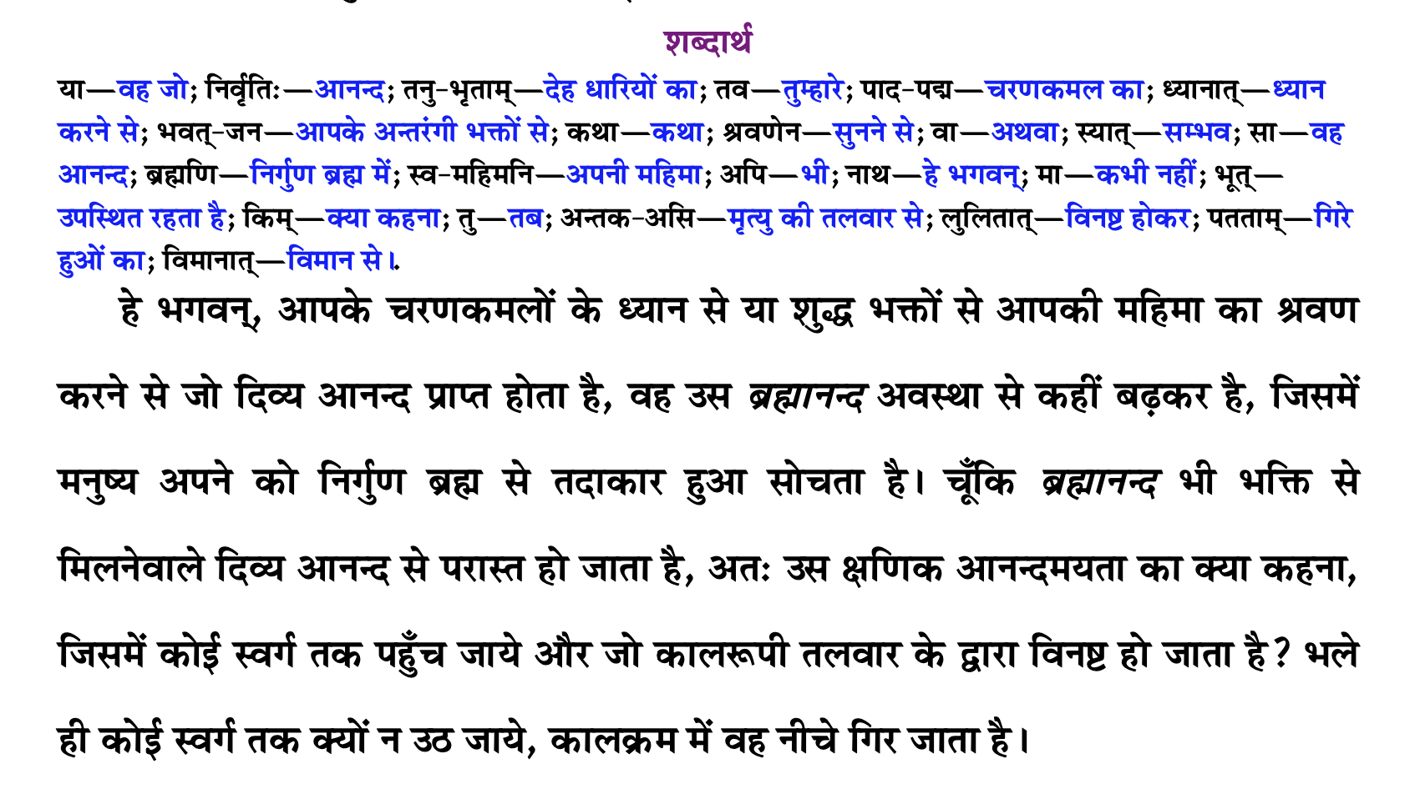

Slide 28
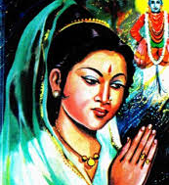
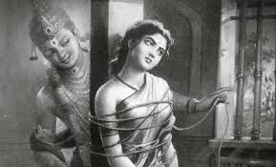
Sant Sakhu Bai
Sakhu Bai, an ardent devotee of Vitthal, lives with her husband and a cruel mother-in-law.
Sakhu bears all all ill-treatment silently. Serving Vitthal with all her hear she forgets her sufferings.
Sakhu sees a group of Vitthala devotees doing Naam-Kirtan. She joins

Slide 29
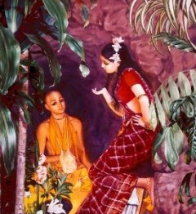
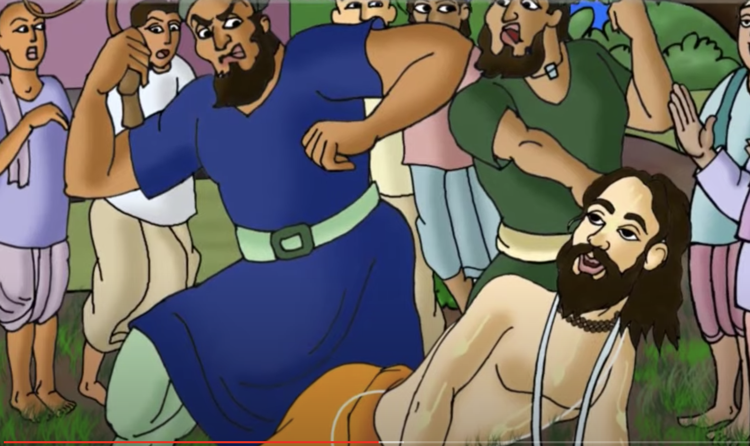
Tolerance Personified
Despite extreme misery of life of should never stop chanting the names of Lord Sri Krishna
Despite all allurements one should never stop chanting the names of Lord Sri Krishna

Slide 30
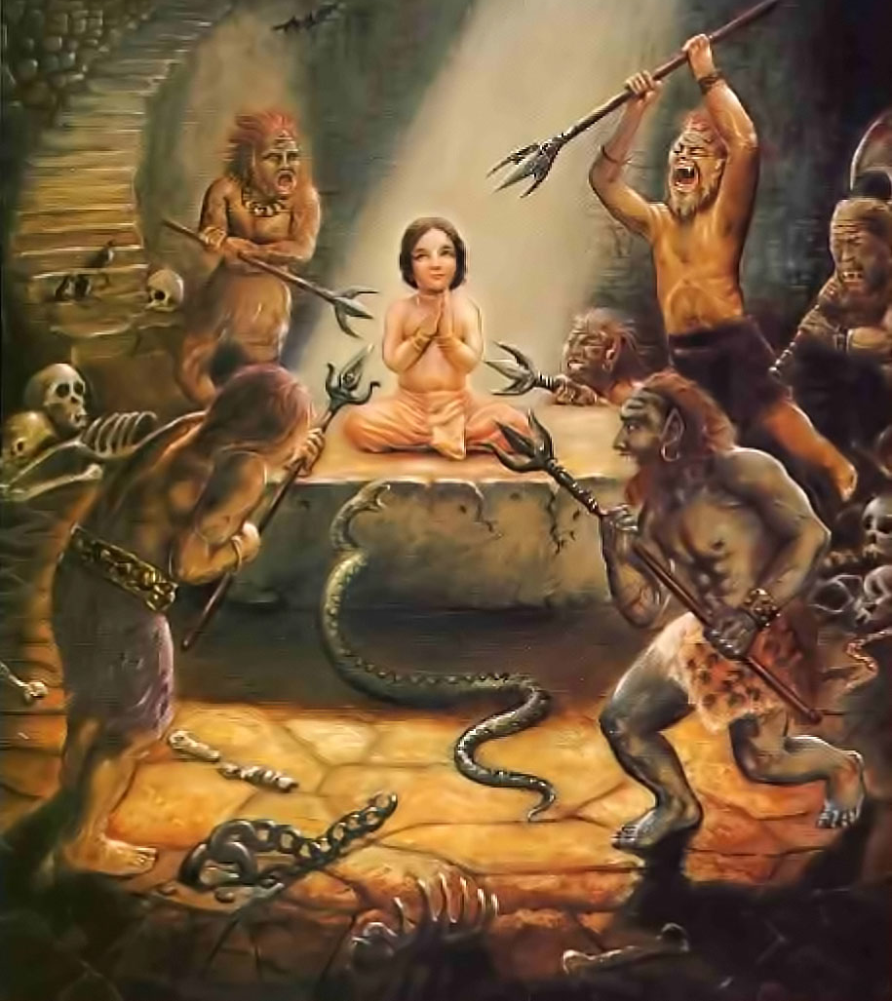
Tolerant Bhakta Prahlad

Slide 31
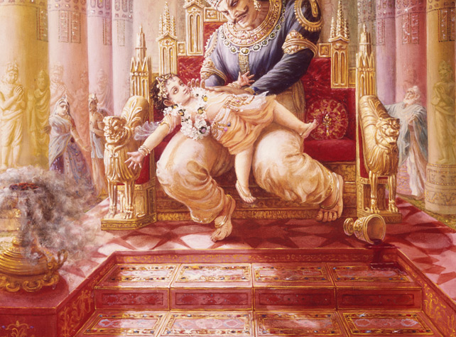

Slide 32
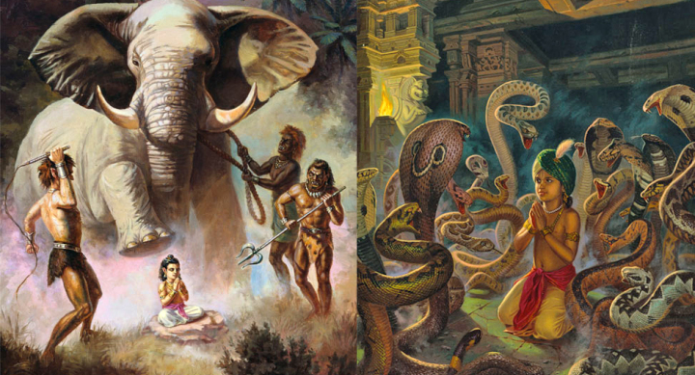

Slide 33
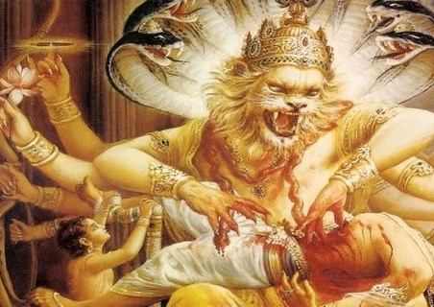
त्रैपिष्टपोरुभयहा स नृसिंहरूपं कृत्वा भ्रमद्भ्रुकुटिदंष्ट्रकरालवक्त्रम् । दैत्येन्द्रमाशु गदयाभिपतन्तमारा- दूरौ निपात्य विददार नखै: स्फुरन्तम् ॥ १४ ॥
trai-piṣṭaporu-bhaya-hā sa nṛsiṁha-rūpaṁ kṛtvā bhramad-bhrukuṭi-daṁṣṭra-karāla-vaktram daityendram āśu gadayābhipatantam ārād ūrau nipātya vidadāra nakhaiḥ sphurantam
The Personality of Godhead assumed the incarnation of Nṛsiṁhadeva in order to vanquish the great fears of the demigods. He killed the king of the demons [Hiraṇyakaśipu], who challenged the Lord with a club in his hand, by placing the demon on His thighs and piercing him with His nails, rolling His eyebrows in anger and showing His fearful teeth and mouth.

Slide 34
Prayer unto lotus feet of Gurudeva that I may please learn how to …
Learn to tolerate with full faith in Lord Krishna
Stop blaming/retaliating, fearing
Introspect
understand why suffering and how to stop the suffering
See the hand of Krishna
When sick eat less and read more
Chant the holy names of the Lord without any offence
Humility, Tolerance and with expectation of respect, respecting all
Chant clearly, attentively and seriously
Read, study and introspect literatures that glorify Lord Sri Krishna
Perform duties with responsibility and good behavior while remembering Lord.
Eagerly seek guidance and lovingly serve Gurudeva

Slide 35
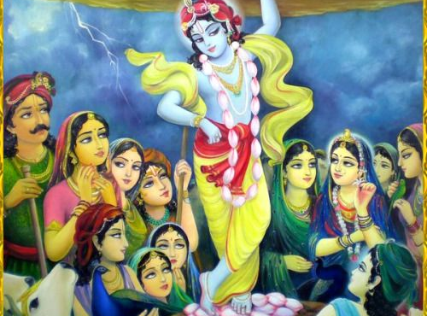

Slide 36
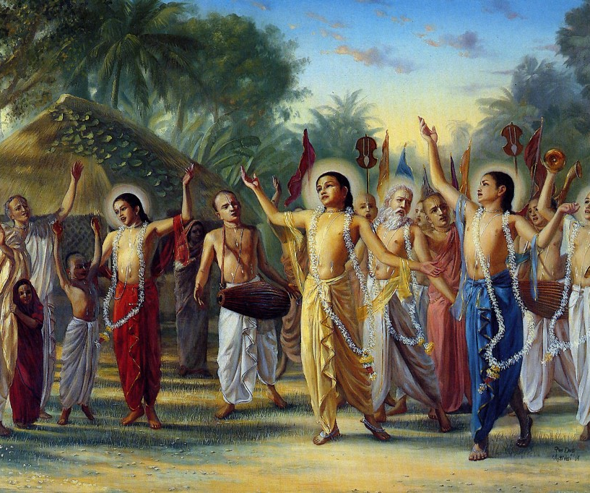
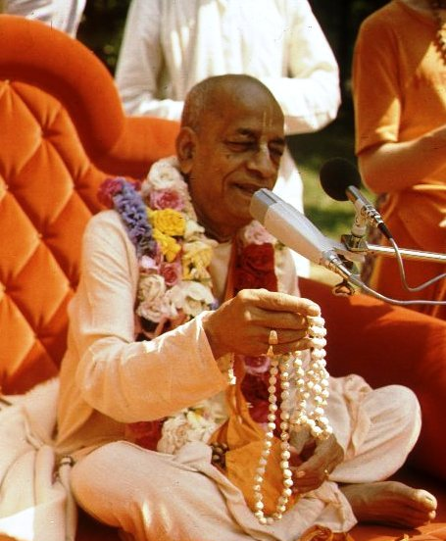
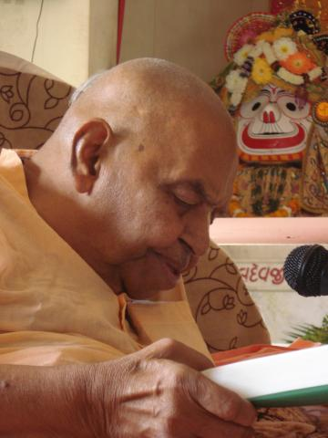
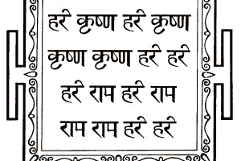
हरे कृष्णा
श्रील प्रभुपाद की जय
गुरुदेव की जय

